Slide 1

Revenue
Month
Week
Properties
Cities
Booking
Month
Week
Properties
Cities
Rating Analysis Report
Total Rating given
Improvement
AtliQ Hospitality Analysis Report

Slide 2

Revenue

Slide 3
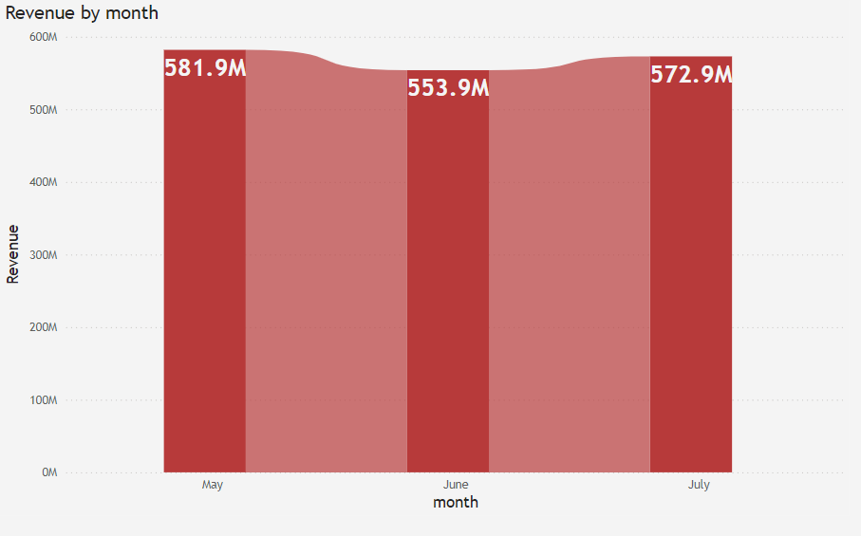
Month Performance Analysis
Revenue Analysis Report for May, June, and July:
In May, the total revenue amounted to 581.9 million, reflecting strong performance during the month.
However, in June, revenue slightly decreased to 553.9 million, representing a -4.81% decline compared to May. This dip can be attributed to seasonal fluctuations, where typically lower demand or market conditions may have contributed to the reduction.
Moving into July, the revenue showed a slight recovery, reaching 572.5 million, which marks a 3.43% increase compared to June . This improvement suggests a partial rebound, potentially driven by market adjustments, promotional efforts, or other seasonal factors that contributed to an uptick in sales during this period.
Overall, while the revenue figures fluctuated over the three months, the data indicates typical seasonal volatility, with a dip in June followed by a recovery in July.

Slide 4
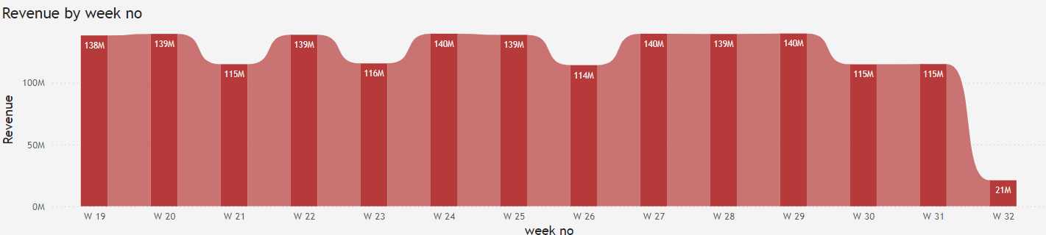
Week Performance Analysis
Revenue Fluctuation Analysis by Week:
From Week 19 to Week 29, the revenue has shown a relatively consistent trend, fluctuating between 114 M to 140 M, with variations ranging from 16% to 22%. This indicates a moderate level of volatility, possibly influenced by regular business cycles, demand shifts, or external market factors. Despite the fluctuations, the revenue remained within a certain range, highlighting a stable performance with periodic peaks and dips.
However, from Week 30 to Week 31, the revenue sharply declined to the range of 114 M to 115 M. This represents a slight dip, maintaining the lower end of the previous range, indicating potential seasonal or operational factors contributing to the reduced performance during this period.
The most notable change occurs in Week 32, where the revenue drastically drops to 21.01 M, reflecting an 81.74% decrease compared to the prior week. This sharp decline is a significant outlier and may indicate a serious disruption, potentially caused by factors such as seasonal changes, market conditions, or an unforeseen external event.
Understanding the specific causes behind these fluctuations is crucial for future planning and for minimizing the impact of such sharp drops. Exploring the external factors that led to the 81.74% decrease in Week 32 will help anticipate similar challenges in the future and allow for more resilient strategies moving forward.

Slide 5
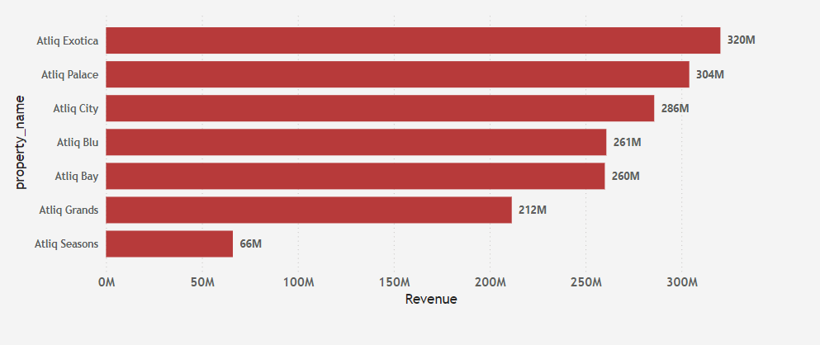
Properties
Revenue Comparison between Properties:
Atliq Exotica vs. Atliq Palace:
5.26% higher revenue for Atliq Exotica.
Atliq Exotica vs. Atliq City:
11.9% higher revenue for Atliq Exotica.
Atliq Exotica vs. Atliq Blu:
22.6% higher revenue for Atliq Exotica.
Atliq Exotica vs. Atliq Bay:
23.1% higher revenue for Atliq Exotica.
Atliq Exotica vs. Atliq Grands:
51.89% higher revenue for Atliq Exotica.
Atliq Exotica vs. Atliq Seasons:
384.8% higher revenue for Atliq Exotica
Improvement:
Atliq Grands:
Revamp marketing strategies and improve guest experience to enhance competitiveness.
Atliq Seasons:
Focus on improving service quality, reevaluating pricing, and launching targeted promotions to attract more customers.
Replicate Success of Atliq Exotica:
Analyze best practices in customer engagement, location advantages, and marketing strategies.
Apply these insights to improve performance at underperforming properties
.By implementing focused strategies, Atliq can achieve a more balanced and sustainable growth trajectory across its properties.

Slide 6
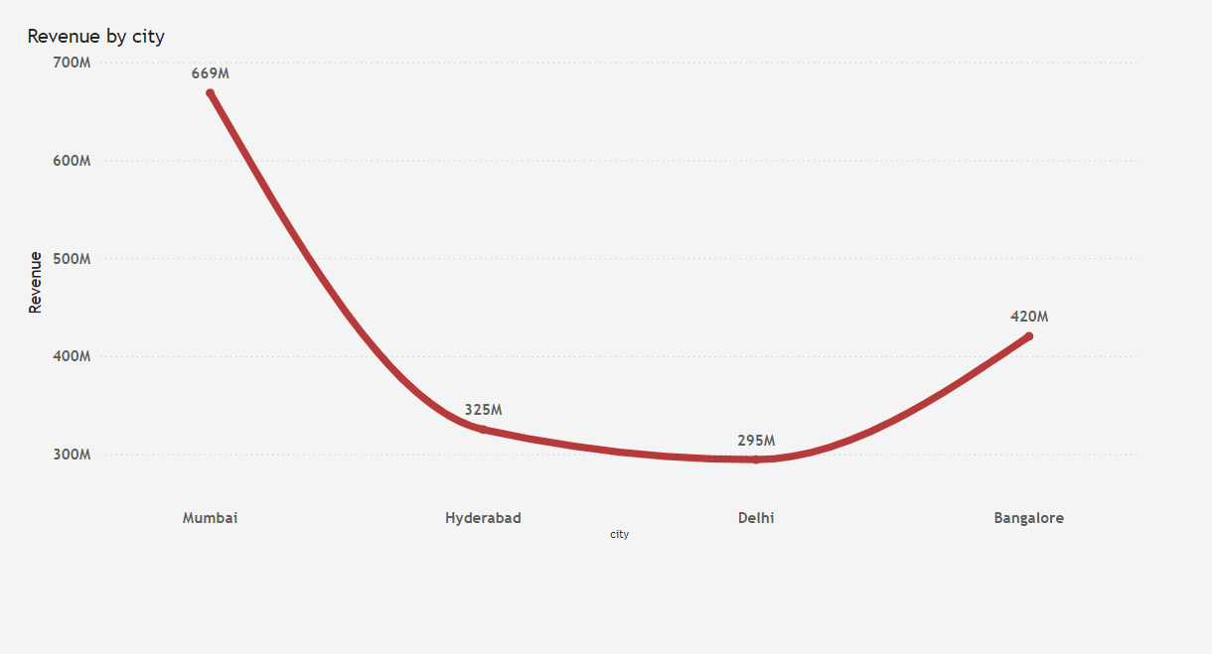
City Performance Comparison:
When comparing the performance across various cities, Mumbai emerges as the clear leader, generating the highest revenue of 669M, far surpassing other cities. Bangalore follows with 420M in revenue, while Hyderabad generates 352M. Delhi lags behind, with the lowest revenue of 294M, reflecting a significant underperformance compared to the other cities.
Revenue Comparison:
Mumbai vs. Hyderabad: Mumbai’s revenue is 89.91% higher than Hyderabad’s, showcasing a considerable gap.
Mumbai vs. Bangalore: Mumbai’s revenue is 59.3% higher than Bangalore’s, again indicating a strong performance advantage.
Mumbai vs. Delhi: Mumbai generates 127.55% more revenue than Delhi, with a striking difference in performance.
Hyderabad vs. Bangalore: Hyderabad’s revenue is 16.66% higher than Bangalore’s, showing a moderate difference.
Hyderabad vs. Delhi: Hyderabad generates 19.73% more revenue than Delhi, demonstrating better overall performance.
Bangalore vs. Delhi: Bangalore’s revenue is 42.86% higher than Delhi’s, further emphasizing the performance gap.
Improvement:
Mumbai stands out as the top performer, with significant leads over the other cities in both revenue. To replicate Mumbai’s success, future growth efforts should focus on improving performance in Bangalore and Delhi, with particular attention needed for Delhi, the current underperformer. Enhancing customer experience and targeted marketing strategies will be key to driving future revenue growth in these cities.
Cities

Slide 7

Booking

Slide 8
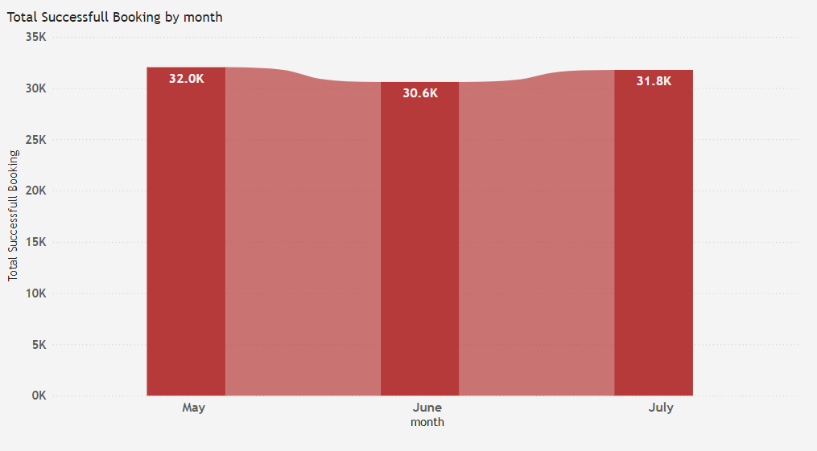
Month
May: 32.0k bookings, reflecting strong performance.
June: 30.6k bookings, a slight decrease of -4.48% compared to May, attributed to seasonal fluctuations and market conditions.
July: 31.8k bookings, a slight increase of 3.83% compared to June, indicating a recovery likely driven by market adjustments or other seasonal factors.
Overall trend: Bookings experienced typical seasonal fluctuations, with a dip in June followed by a recovery in July
Bookings fluctuated between a -4.6% decrease and a 4% increase, showing typical seasonal variation and market conditions over the three months.

Slide 9
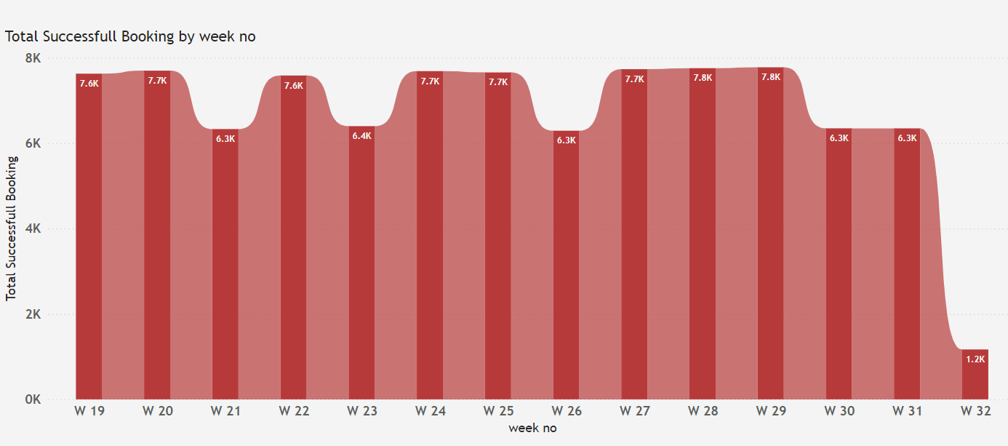
Weeks
From Week 19 to Week 29, the weekly bookings have shown a relatively consistent trend, the fluctuations between 6.3k to 7.8k represent an increase of approximately 23.81% and a decrease of 19.23%.This indicates a moderate level of volatility, which could be influenced by regular business cycles, demand shifts, or external market factors. Despite the fluctuations, bookings remained within a certain range, reflecting stable performance with periodic peaks and dips.
However, from Week 30 to Week 31, the bookings slightly decreased to the range of 6.3k, maintaining the lower end of the previous range. This suggests potential seasonal or operational factors that contributed to the reduced bookings during this period.
The most significant change occurs in Week 32, where the bookings drastically drop to 1.2k, reflecting an 81.58% decrease compared to the prior week. This sharp decline is an outlier and may indicate a serious disruption, potentially caused by factors such as seasonal changes, market conditions, or an unforeseen external event.
Understanding the specific causes behind these fluctuations is crucial for future planning and for minimizing the impact of such sharp drops. In particular, exploring the external factors that led to the 81.58% decrease in Week 32 will help anticipate similar challenges in the future and enable more resilient strategies moving forward

Slide 10
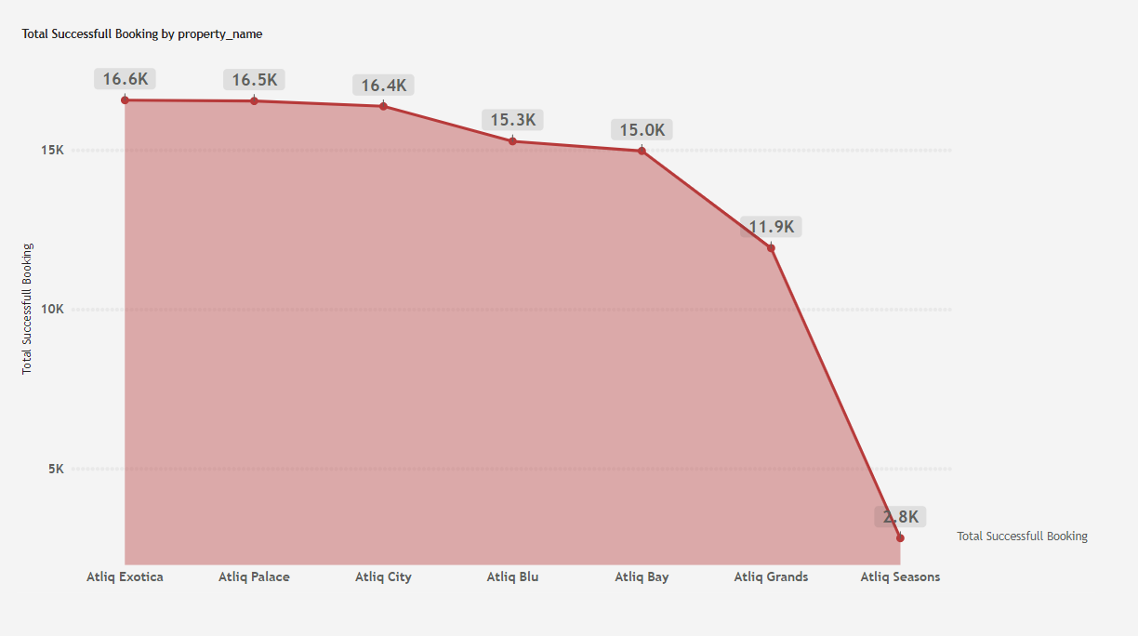
Properties
Performance Comparison: Atliq Properties (Bookings) - Percentage Breakdown
Atliq Exotica and Atliq Palace:
Both lead with 16,600 bookings, showcasing 100% of the top booking performance in this comparison.
Atliq City:
16,400 bookings, showing a 1.20% decrease compared to Atliq Exotica and Atliq Palace.
Atliq Blu:
15,300 bookings, showing a 7.89% decrease compared to Atliq Exotica and Atliq Palace.
Atliq Bay:
15,000 bookings, showing a 9.64% decrease compared to Atliq Exotica and Atliq Palace.
Atliq Grands:
11,900 bookings, showing a 28.62% decrease compared to Atliq Exotica and Atliq Palace.
Atliq Seasons:
2,800 bookings, showing an 83.12% decrease compared to Atliq Exotica and Atliq Palace.
Conclusion:
Atliq Exotica and Atliq Palace are leading in bookings.
Atliq City is close behind with a slight decline.
Atliq Blu, Atliq Bay, and Atliq Grands show moderate declines.
Atliq Seasons shows a sharp 83.12% decrease, highlighting the need for significant improvement.

Slide 11
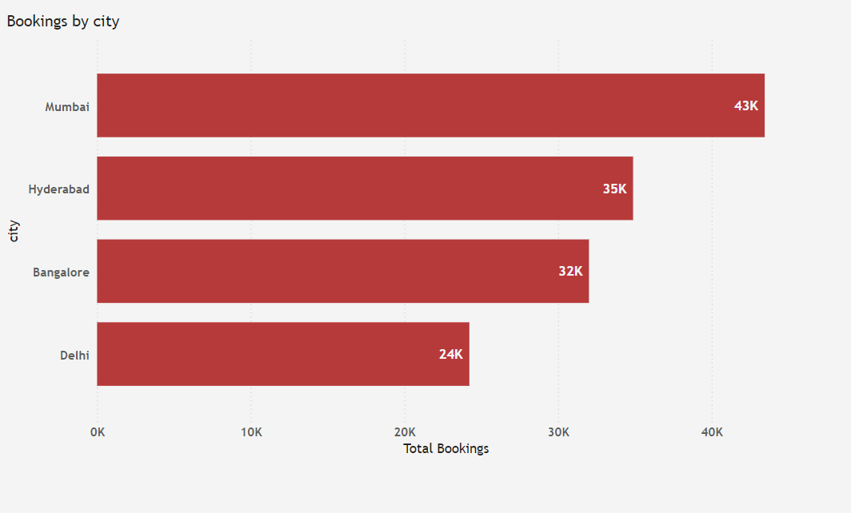
Booking Comparison:
Mumbai vs. Hyderabad:
Mumbai has 24.74% more bookings than Hyderabad.
Mumbai vs. Bangalore:
Mumbai outperforms Bangalore by 35.74% in bookings.
Mumbai vs. Delhi:
Mumbai generates 79.32% more bookings than Delhi.
Hyderabad vs. Bangalore:
Hyderabad has 8.97% more bookings than Bangalore.
Hyderabad vs. Delhi:
Hyderabad generates 43.96% more bookings than Delhi.
Bangalore vs. Delhi:
Bangalore leads Delhi by 32.11% in bookings.
Future Focus:
Replicating Mumbai’s success: Efforts should be focused on improving performance in Bangalore and Delhi.
Customer experience and targeted marketing: These strategies should be prioritized in Bangalore and Delhi to increase bookings.
Improving Delhi’s performance: It is crucial to focus on strategies to boost bookings and address the significant performance gap in Delhi.

Slide 12

Rating Analysis Report

Slide 13
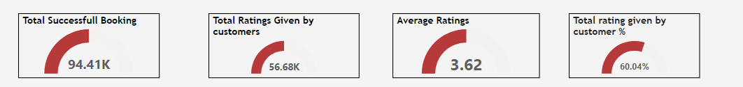
Overview:
The hotel has successfully achieved 94.41K bookings, with an average guest rating of 3.62, based on 56.5K ratings that account for 60% of successful bookings. Striving to achieve 100% guest ratings would significantly enhance the hotel’s reputation, increase revenue, boost room bookings, and improve its market competitiveness—ultimately attracting more customers and setting us apart from competitors.
Improvement
City Rating Comparison:
In terms of city performance:
Bangalore holds an average rating of 3.41, which is 5.8% lower than the average rating of 3.62.
Mumbai holds a higher rating of 3.65, outperforming Bangalore.
This suggests that there is room for improvement in Bangalore, and by enhancing the service quality, we can work toward closing the gap and boosting the ratings to align more closely with the average rating.
Property Ratings
When comparing the ratings of our properties:
The average rating is 3.62, which is 58.1% higher than Atliq Season's rating of 2.29.
Atliq Grand holds a rating of 3.10, which is 16.9% higher than Atliq Season's rating of 2.29 and 14.4% lower than the average rating of 3.62.
This comparison clearly shows that Atliq Blu is performing at a significantly higher level compared to both Atliq Season and Atliq Grand, indicating the need for focused efforts to improve service quality at Atliq Season to elevate its rating closer to the overall average rating.
Conclusion:
Achieve 100% guest ratings would significantly enhance the hotel’s reputation, increase revenue, boost room bookings, and improve its market competitiveness—ultimately attracting more customers and setting us apart from competitors.

